Slide 1
EMTH1019 – Teaching Weeks 5, 6 & 7
Vectors
Magnitude & Unit Vectors
Dot Product & Cross Product
Angle between vectors
Scalar & Vector Projection
Work Done F.s
Direction cosines
Area of a parallelogram
Volume of a parallelpiped
Coplanar
Matrices
Dimensions – Rows by columns
Addition, subtraction & multiplication
Identity matrix
Matrix Algebra
Transpose, Inverse & Symmetric
Linear Equations
Gaussian Elimination
Augmented matrix
Row echelon form
Rank and the nature of solutions

Slide 2
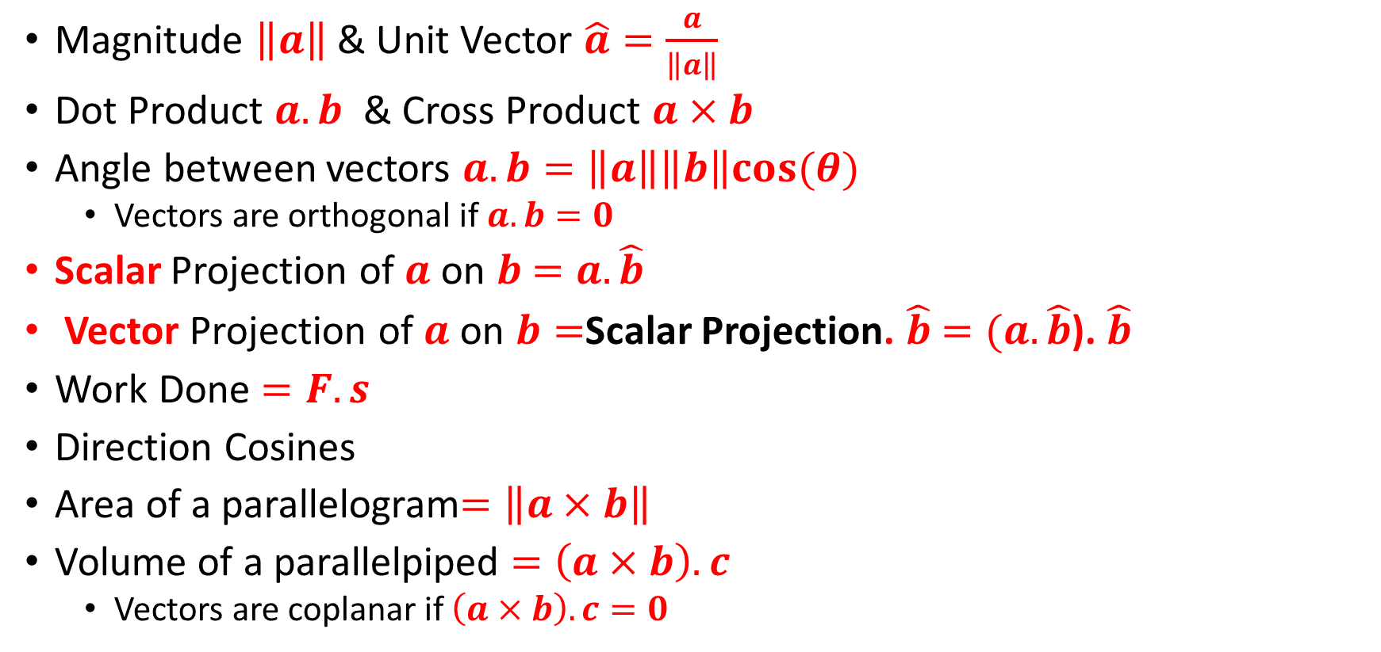
Vectors
Magnitude $\left\|a\right\|$ & Unit Vector $\hat{a}=\frac{a}{\left\|a\right\|}$
Dot Product $a.b$ & Cross Product $a×b$
Angle between vectors $a.b=\left\|a\right\|\left\|b\right\|cos⁡(θ)$
Vectors are orthogonal if $a.b=0$
Scalar Projection of $a$ on $b$ $=a.\hat{b}$
Vector Projection of $a$ on $b=$Scalar Projection. $\hat{b}$ $=(a.\hat{b}$). $\hat{b}$
Work Done $=F.s$
Direction Cosines
Area of a parallelogram$=\left\|a×b\right\|$
Volume of a parallelpiped $=\left(a×b\right).c$
Vectors are coplanar if $\left(a×b\right).c=0$

Slide 3
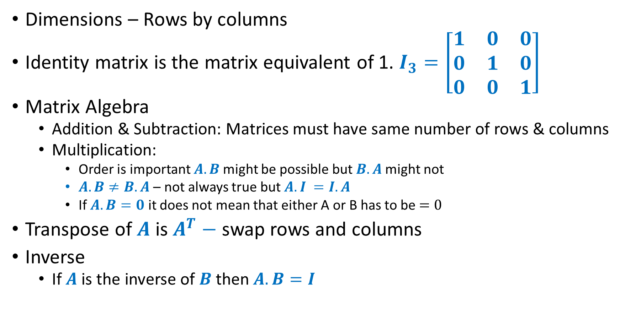
Matrices
Dimensions – Rows by columns
Identity matrix is the matrix equivalent of 1. $I_{3}=\left[\begin{matrix}1 & 0 & 0 \\ 0 & 1 & 0 \\ 0 & 0 & 1\end{matrix}\right]$
Matrix Algebra
Addition & Subtraction: Matrices must have same number of rows & columns
Multiplication:
Order is important $A.B$might be possible but $B.A$might not
$A.B≠B.A$ – not always true but$A.I =I.A$
If $A.B=0$ it does not mean that either A or B has to be $=0$
Transpose of $A$ is $A^{T}−$ swap rows and columns
Inverse
If $A$ is the inverse of $B$ then$A.B=I$

Slide 4
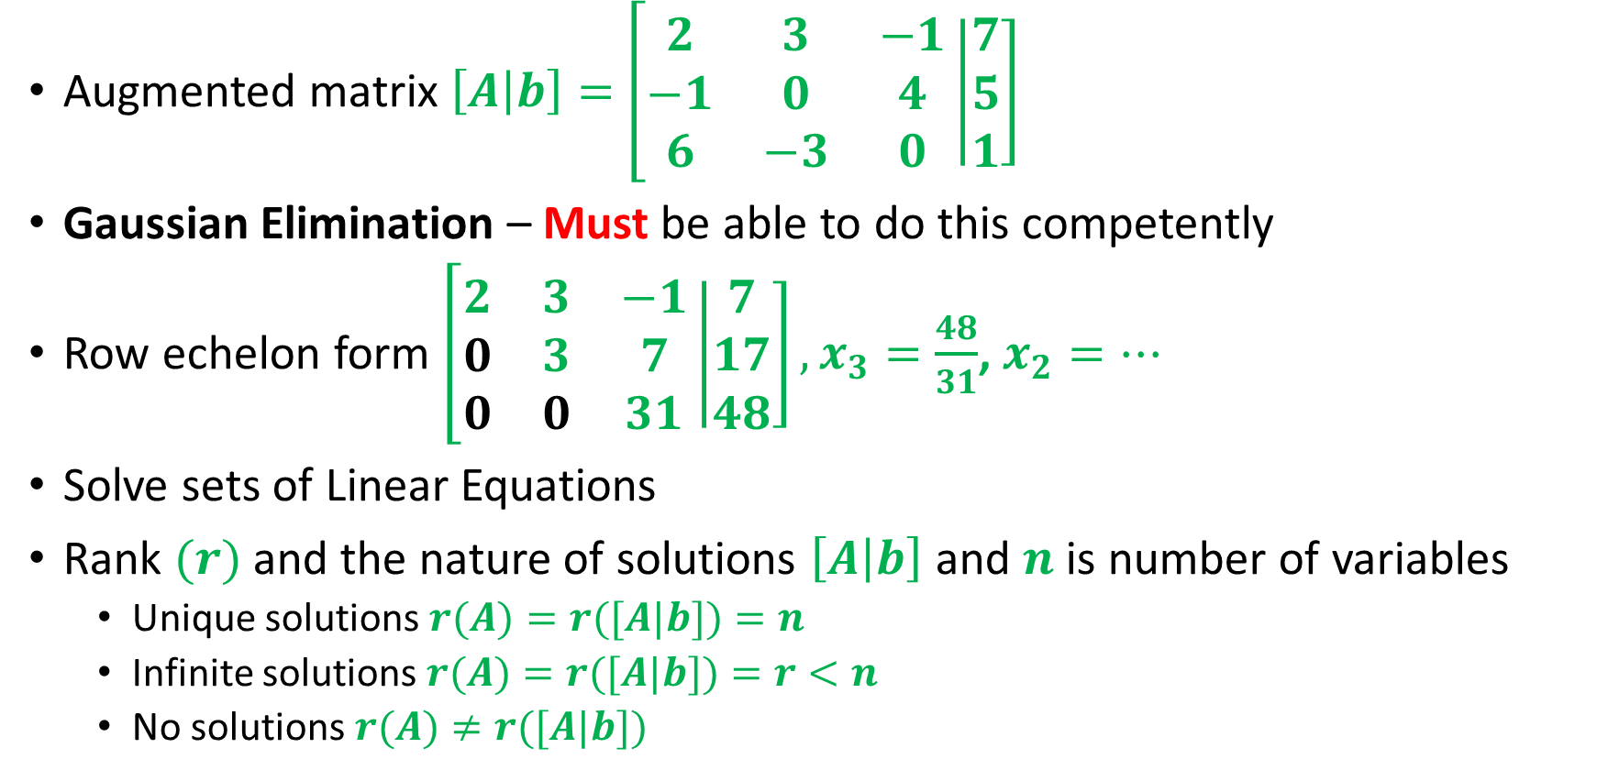
Linear Equations
Augmented matrix $\left[A\right.\left|\left.b\right]\right.=$ $\left[\begin{matrix}2 & 3 & −1 \\ −1 & 0 & 4 \\ 6 & −3 & 0\end{matrix}\right.\left|\left.\begin{matrix}7 \\ 5 \\ 1\end{matrix}\right]\right.$
Gaussian Elimination – Must be able to do this competently
Row echelon form $\left[\begin{matrix}2 & 3 & −1 \\ 0 & 3 & 7 \\ 0 & 0 & 31\end{matrix}\right.\left|\left.\begin{matrix}7 \\ 17 \\ 48\end{matrix}\right]\right., x_{3}=\frac{48}{31}$, $x_{2}=…$
Solve sets of Linear Equations
Rank $(r)$and the nature of solutions $\left[A\right.\left|\left.b\right]\right.$ and $n$ is number of variables
Unique solutions $r(A)=r([A|b])=n$
Infinite solutions $r(A)=r([A|b])=r<n$
No solutions $r(A)≠r([A|b])$

Slide 5
Main Techniques used
Multiplication
Dot product
Cross Product
Matrix
Gaussian elimination

